Slide 1

Starting Windows
© Microsoft Corporation

Slide 2



Slide 3


Welcome
Windows 7 in PowerPoint
®
®

Slide 4


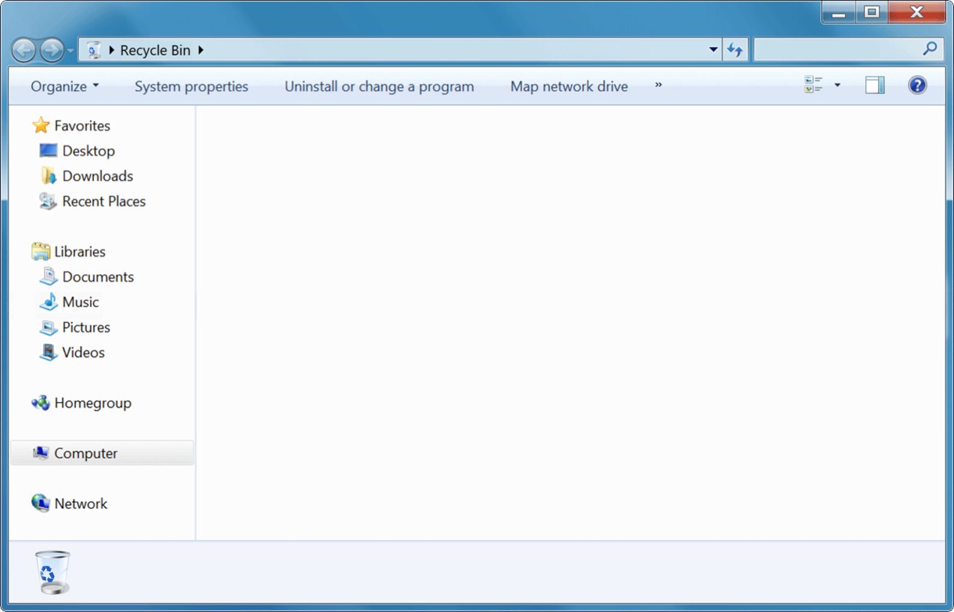
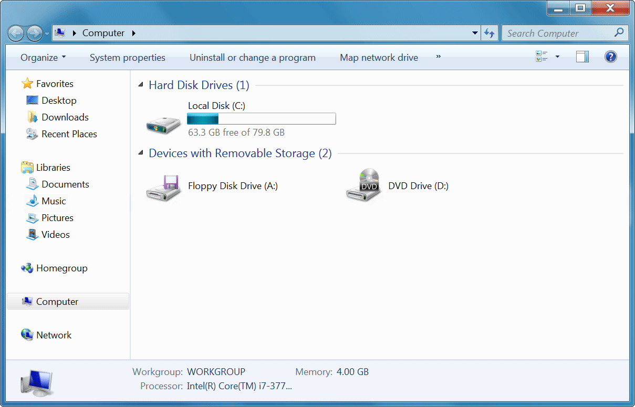












Recycle Bin
Computer
Sticky Notes
Calculator
User
Snipping Tool
Documents
Pictures
Paint
Music
Computer
Control Panel
Default Programs
‣
Help and Support
All Programs
Search programs and files
Shut down
►

Slide 5
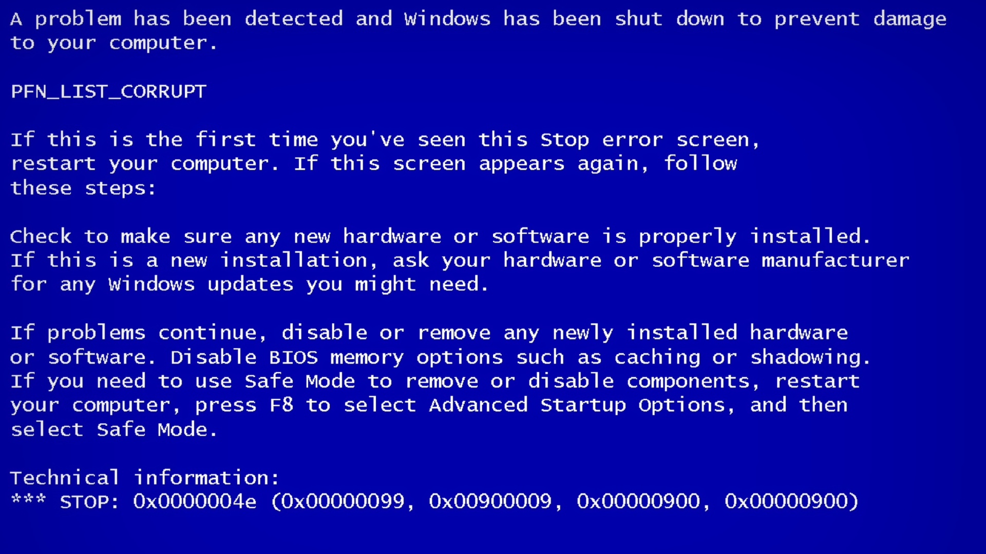

Slide 6
Shutting down…
Windows 7 in PowerPoint
®
®

